Slide 1



Bank Loan Analysis
P929 | Group 6 |

Slide 2


C ONT E NT S
Introduction
KPI-1 : Year wise loan amount Status
KPI-2 : Grade and sub grade wise revol bal
KPI-3 : Total Payment for Verified Status Vs Total Payment
for Non Verified Status
KPI-4 : State wise and Month wise Loan status
KPI-5 : Home ownership vs Last payment date status
Dashboards : Excel, Power BI & Tableau

Slide 3

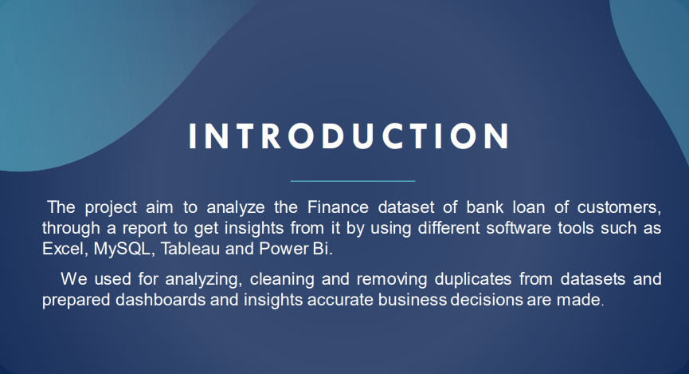


Slide 4
DATA S E T
Data Set | Finance_1 | Finance_2
No. of Rows | 39k | 39k
No. of Columns | 24 | 25
File Format | .csv | .xlsx
Dataset type | Excel Data | Excel Data

Slide 5
Tools Used In the Project
Excel
MySQL
Tableau
Power-BI
Data Exploration
Retrieving
Relevant Data according to KPIs
Joining multiple Files
Visualization
Data Exploration
Data Cleaning
Visualization
Joining multiple Files
Data Exploration
Data Cleaning in Power Query
Visualization

Slide 6





DATA A N A LY S IS P RO C E S S
Step 1
Define the Question
Step 2
Collect the data
Step 3
Clean the data
Step 4
Analyze the data
Step 5
Visualize and Share the Insights

Slide 7



KPI-1 : Y E A R W I S E LOAN AMOUNT S T A T US
By observing this chart we can see how loan amount is increasing by year.
It is continuously increasing by each year as you see it‘s varies from 2M to 261M between the years 2007 to 2011.
From the year 2009, The changes in loan amount is suddenly increased with a higher rate that is around 5 times for next 2 years as compared to pervious years.
Year wise loan Amount
2011
$261 M
2010
$122 M
2009
$46 M
2008
$14 M
2007
$2 M

Slide 8
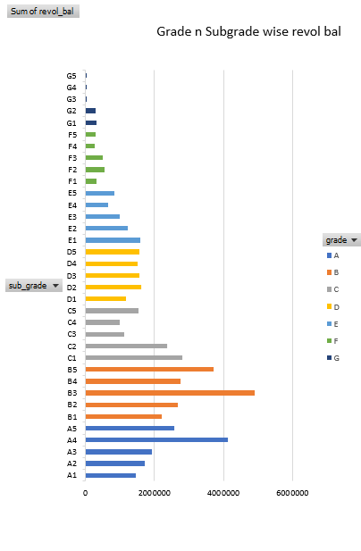
KPI-2 : G R A D E AND S U B G R A D E W I S E R E V O L_B A L
A4
$35.30 M
In this Grade and subgrade wise revol balance we can notice Grade B have more revol balance then any other grades & Grade G have very low revol balance.
The average revolving balance is higher in the ‘grade B’ its around 29M and the maximum reaches in the ‘sub-grade B1’ that is 39M, Same like the average lower revolving balance is in ‘grade G’ its around 1200K and the minimum reaches in the ‘sub-grade G5’ that is 701k.
A3
$19.54 M
$34.56 M
A2
$14.0 M
A1
B5
$37.86 M
B4
$35.41 M
B
B3
$39.72 M
B2
$26.48 M
B1
$21.84 M
C5
$16.02 M
C4
$16.87 M
C
C3
$20.53 M
C2
$27.32 M
C1
$29.38 M
D5
$13.25 M
D4
$13.74 M
D
D3
$16.79 M
D2
$18.57 M
D1
$12.13 M
E5
$7.67 M
E4
$7.99 M
E
E3
$9.04 M
E2
$10.24 M
E1
$11.13 M
F5
$2.19 M
F4
$2.55 M
F
F3
$3.18 M
F2
$4.53 M
F1
$5.84 M
G5
$.70 M
G4
$1.39 M
G
G3
$.83 M
G2
$1.73 M
G1
$1.81 M

Slide 9
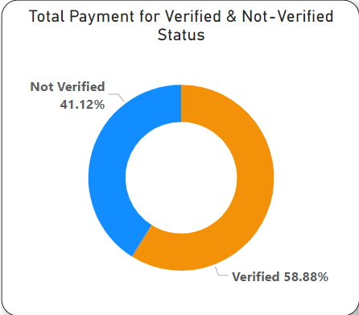
KPI-3 : T O T A L P A Y M E N T F O R V E R I F I E D VS NON V E R I F I E D S T A T U S
As we Can see in the Donut Chart that Out of $373 Million only 59% are verified i.e.
$220million
41% of $373 Million are not verified i.e. $ 154 Million. Which might be a threat to company, Should inform the verification team to take required action regarding that.

Slide 10


KPI-4 : S T A T E W I SE AND MONTH W I SE LOAN ST AT U S
Month wise loan status
$45.0 M
In the data set we have different states and the months along with the 3 types of loan status.
In the state wise loan status we can observe that CA,NY,TX,FL & NJ are the top states to fully paid amount.
In the month wise loan status we can observe that Dec, Nov and oct are the fully paid amount.
Charged Off
Current
Fully Paid
$40.0 M
$35.0 M
$30.0 M
$25.0 M
$20.0 M
$15.0 M
$10.0 M
$5.0 M
$.0 M
Jan Feb Mar Apr May Jun
Jul
Aug Sep Oct Nov Dec
State wise loan status
$90 M
Fully Paid
Current
Charged Off
$80 M
$70 M
$60 M
$50 M
$40 M
$30 M
$20 M
$10 M
$ M
CA
NY TX FL NJ IL VA PA GA MA OH MD AZ WA CO NC CT MI MO MN NV WI SC AL OR LA KY OK KS UT DC AR NH NM WV RI HI DE AK WY MT SD VT TN MS IN ID IA NE ME

Slide 11

KPI-5 : HOME O W N E R S H I P V S L A S T P A Y M E N T D A T E S T A T US
In this chart is shown by the types of home ownerships varies from 2008 to 2016.
In maximum amount reaches in the year 2012 who Rent and Mortgage house owners has paid their last Payment is 12 million and 15 million. And the minimum amount reaches in year 2008 and payment is 0.29 million and 0.31million.
Home ownershipvs Last payment Date
 | 2008 | 2009 | 2010 | 2011 | 2012 | 2013 | 2014 | 2015 | 2016
RENT | $.31 M | $1.0 M | $2.57 M | $7.63 M | $12.83 M | $9.38 M | $5.47 M | $2.02 M | $.49 M
OWN | $.03 M | $.14 M | $1.30 M | $1.57 M | $2.34 M | $1.59 M | $.82 M | $.36 M | $.09 M
OTHER |  | $.04 M | $.07 M | $.05 M | $.01 M |  |  | $.0 M
NONE |  |  | $.0 M | $.0 M
MORTGAGE | $.29 M | $1.0 M | $2.74 M | $10.09 M | $15.83 M | $14.02 M | $8.46 M | $3.05 M | $.81 M

Slide 12

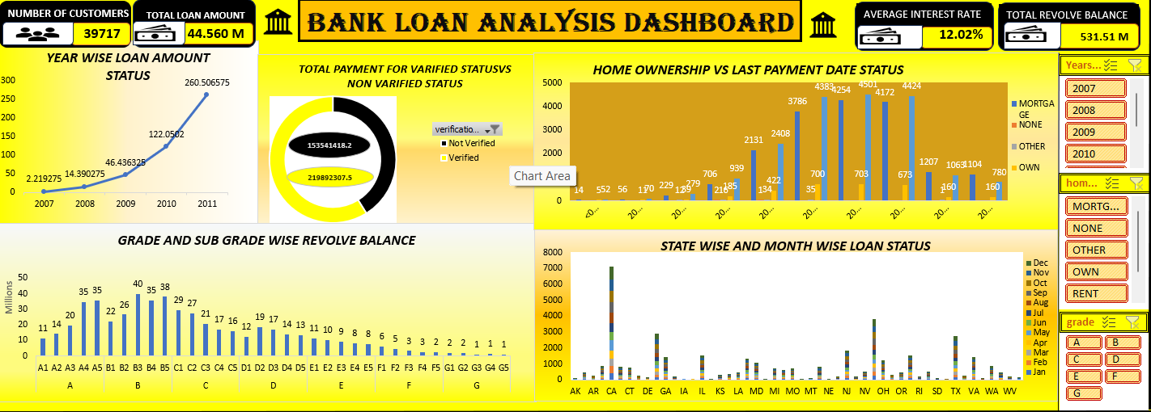
E XCE L DAS H B OAR D

Slide 13

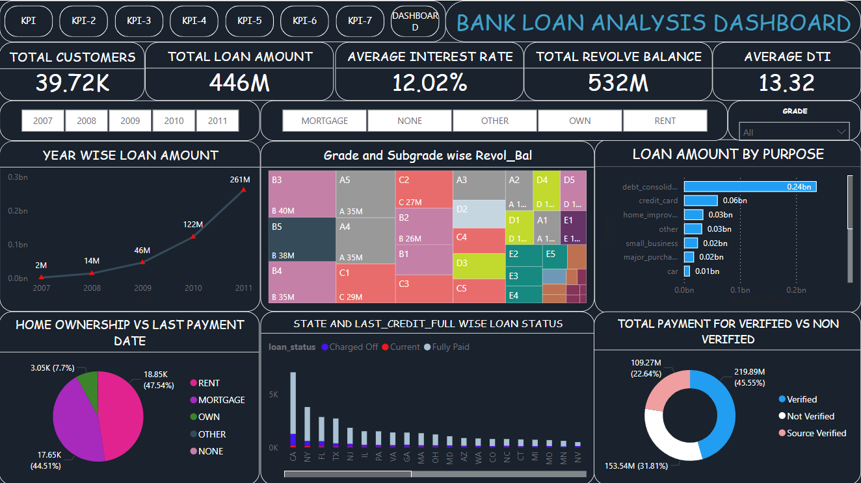
P OW E R B I DAS H B OAR D

Slide 14
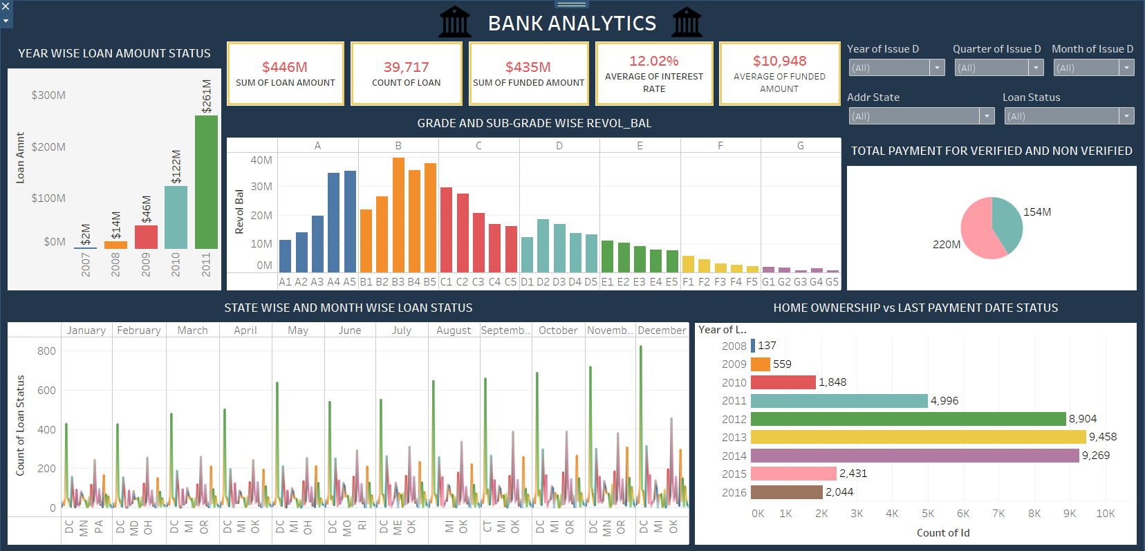
TAB L E AU DAS H B OAR D

Slide 15
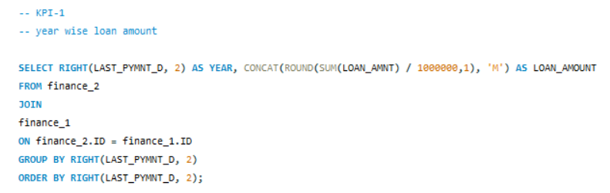
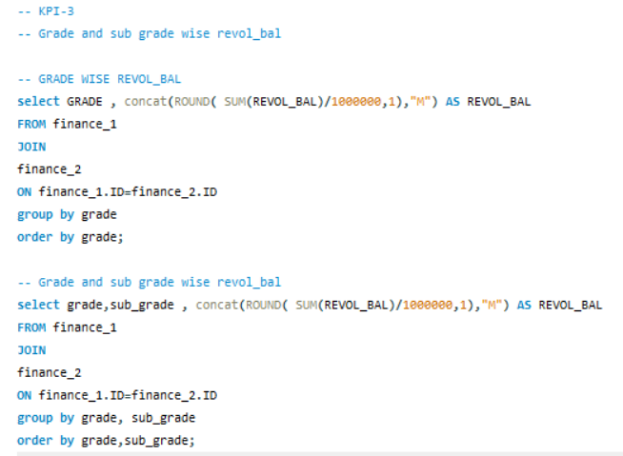
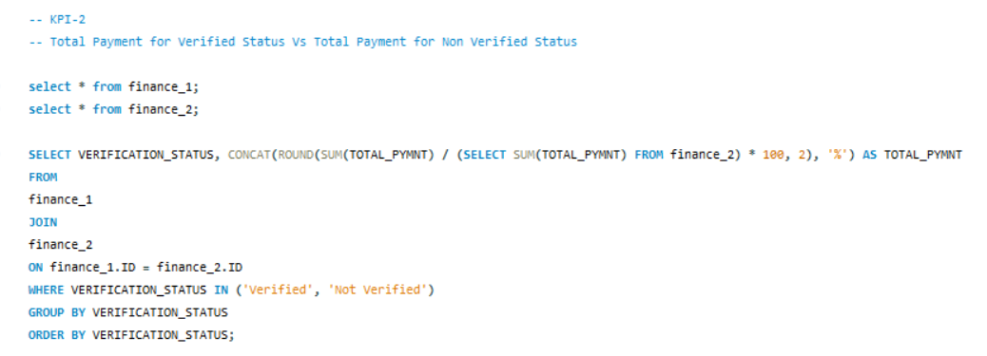
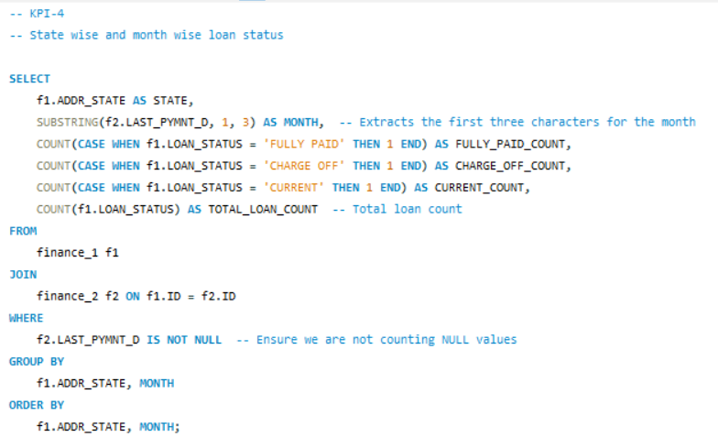
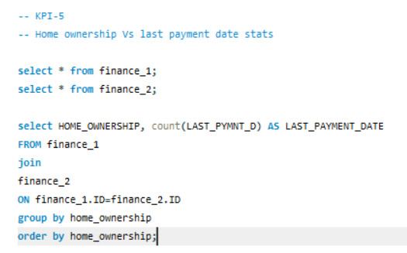
SQL

Slide 16



Slide 17


TH ANK YO U
-Sakshi Rajesh Lahoti
-Arpita Raghoba Devkar
-Vijay R Chandke
-Siva Balaji Budumuri
-Sutar Vijay Sadashiv
-Anusha NS
-Pasala Harshita

